Slide 1
Course name:
Applied Computational Mathematics
Course Code:CSE1001

Slide 2
Module I linear algebra-1

Slide 3
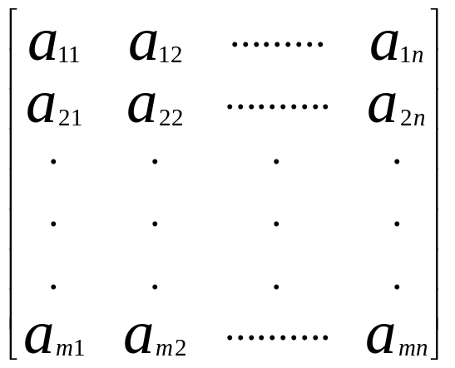

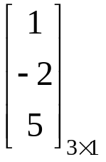
MATRICES
Matrix : A system of mn numbers real (or) complex arranged in the form of an ordered set of ‘m’ rows, each row consisting of an ordered set of ‘n’ numbers between [ ] (or) ( ) (or) || || is called a matrix of order m x n.
Eg:
= [aij ]mxn where1≤i≤m, 1≤j≤n.
Order of the Matrix: The number of rows and columns represents the order of the matrix. It is denoted by
m x n, where m is number of rows and n is number of columns.
Types of Matrices:
Row Matrix: A Matrix having only one row is called a “Row Matrix”.
Ex. A=
Column Matrix: A Matrix having only one column is called a “Column Matrix” .
B=

Slide 8
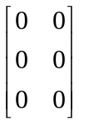
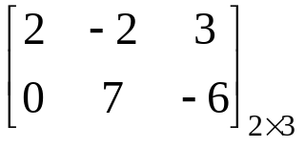
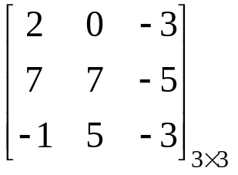
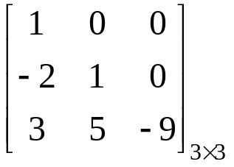
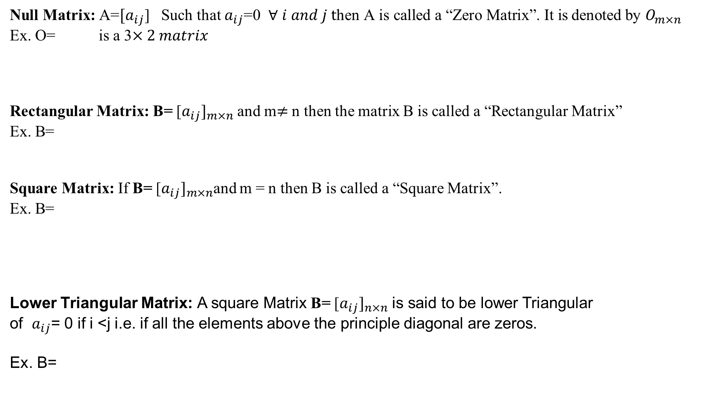
Null Matrix: A=${[a}_{ij}$] Such that $a_{ij}$=0 $∀ i and j \text{t}\text{hen} \text{A} \text{is} \text{called} \text{a}\text{ “}\text{Zero} \text{Matrix}\text{”. }\text{It} \text{is}$ denoted by $O_{m×n}$
Ex. O= is a 3$×2 matrix$
Rectangular Matrix: B= [${a_{ij}]}_{m×n}$ and m$≠$ n then the matrix B is called a “Rectangular Matrix”
Ex. B=
Square Matrix: If B= [${a_{ij}]}_{m×n}$and m = n then B is called a “Square Matrix”.
Ex. B=
Lower Triangular Matrix: A square Matrix B= [${a_{ij}]}_{n×n}$ is said to be lower Triangular
of $a_{ij}$= 0 if i <j i.e. if all the elements above the principle diagonal are zeros.
Ex. B=

Slide 9
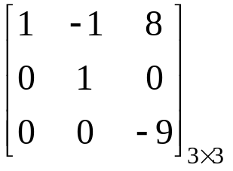
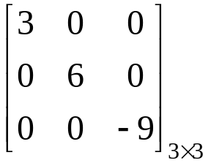
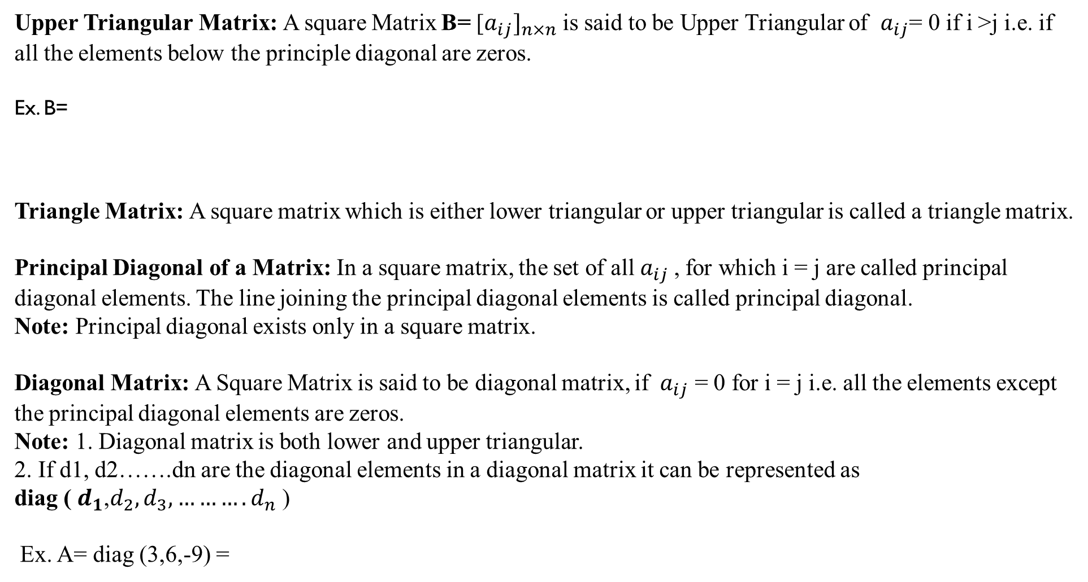
Upper Triangular Matrix: A square Matrix B= [${a_{ij}]}_{n×n}$ is said to be Upper Triangular of $a_{ij}$= 0 if i >j i.e. if all the elements below the principle diagonal are zeros.
Ex. B=
Triangle Matrix: A square matrix which is either lower triangular or upper triangular is called a triangle matrix.
Principal Diagonal of a Matrix: In a square matrix, the set of all${ a}_{ij}$ , for which i = j are called principal diagonal elements. The line joining the principal diagonal elements is called principal diagonal.
Note: Principal diagonal exists only in a square matrix.
Diagonal Matrix: A Square Matrix is said to be diagonal matrix, if ${ a}_{ij}$ = 0 for i = j i.e. all the elements except the principal diagonal elements are zeros.
Note: 1. Diagonal matrix is both lower and upper triangular.
2. If d1, d2…….dn are the diagonal elements in a diagonal matrix it can be represented as
diag ( $d_{1}$,$d_{2}, d_{3}, ……….d_{n}$ )
Ex. A= diag (3,6,-9) =

Slide 10
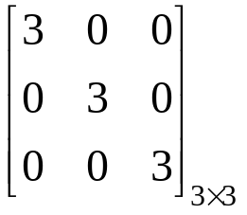
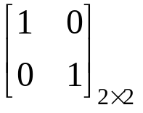
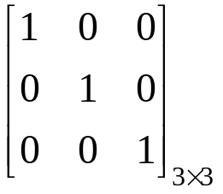
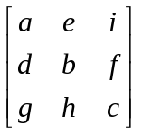
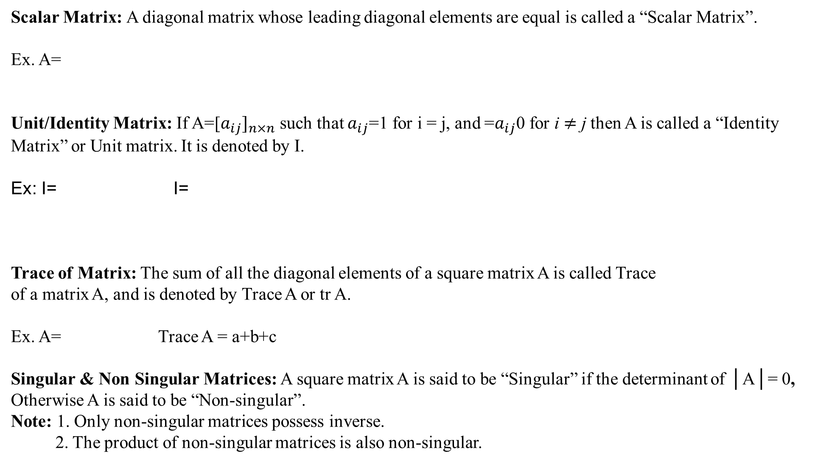
Scalar Matrix: A diagonal matrix whose leading diagonal elements are equal is called a “Scalar Matrix”.
Ex. A=
Unit/Identity Matrix: If A=[${a_{ij}]}_{n×n}$ such that $a_{ij}$=1 for i = j, and =$a_{ij}$0 for i $≠$ j then A is called a “Identity Matrix” or Unit matrix. It is denoted by I.
Ex: I= I=
Trace of Matrix: The sum of all the diagonal elements of a square matrix A is called Trace
of a matrix A, and is denoted by Trace A or tr A.
Ex. A= Trace A = a+b+c
Singular & Non Singular Matrices: A square matrix A is said to be “Singular” if the determinant of │A│= 0, Otherwise A is said to be “Non-singular”.
Note: 1. Only non-singular matrices possess inverse.
2. The product of non-singular matrices is also non-singular.

Slide 11
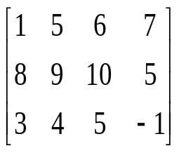
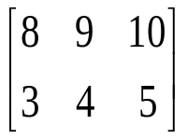
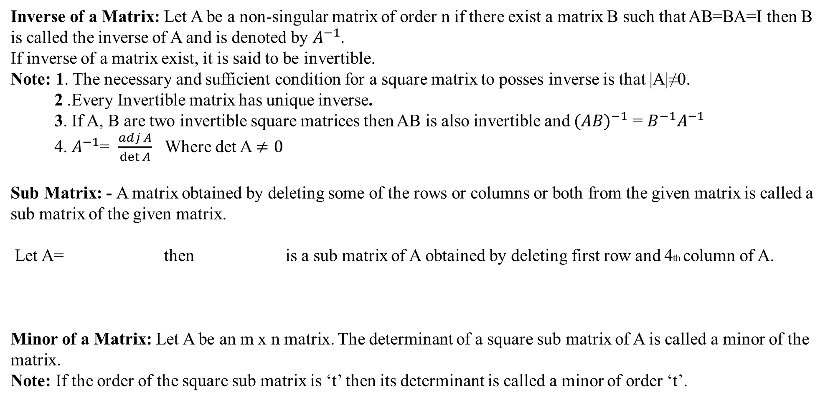
Inverse of a Matrix: Let A be a non-singular matrix of order n if there exist a matrix B such that AB=BA=I then B is called the inverse of A and is denoted by $A^{−1}$.
If inverse of a matrix exist, it is said to be invertible.
Note: 1. The necessary and sufficient condition for a square matrix to posses inverse is that |A|≠0.
2 .Every Invertible matrix has unique inverse.
3. If A, B are two invertible square matrices then AB is also invertible and ${(AB)}^{−1}$ = $B^{−1}A^{−1}$
4. $A^{−1}$= $\frac{adj A}{\det{A}}$ Where det A $≠0$
Sub Matrix: - A matrix obtained by deleting some of the rows or columns or both from the given matrix is called a sub matrix of the given matrix.
Let A= then is a sub matrix of A obtained by deleting first row and 4th column of A.
Minor of a Matrix: Let A be an m x n matrix. The determinant of a square sub matrix of A is called a minor of the matrix.
Note: If the order of the square sub matrix is ‘t’ then its determinant is called a minor of order ‘t’.

Slide 12
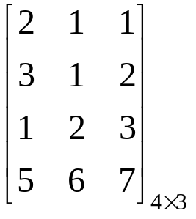
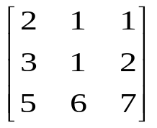
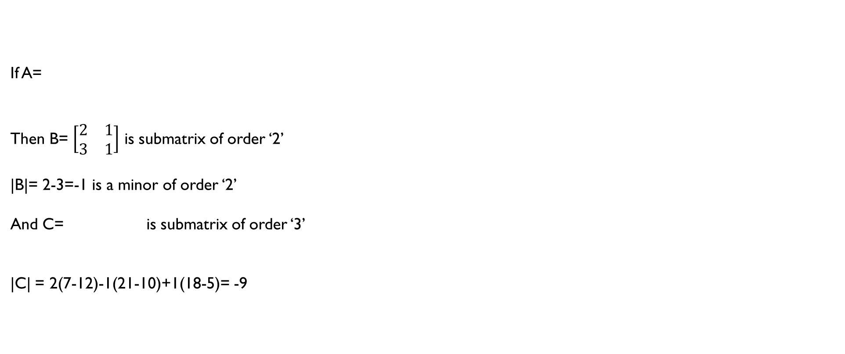
If A=
Then B= $\left[\begin{matrix}2 & 1 \\ 3 & 1\end{matrix}\right]$ is submatrix of order ‘2’
|B|= 2-3=-1 is a minor of order ‘2’
And C= is submatrix of order ‘3’
|C| = 2(7-12)-1(21-10)+1(18-5)= -9

Slide 13
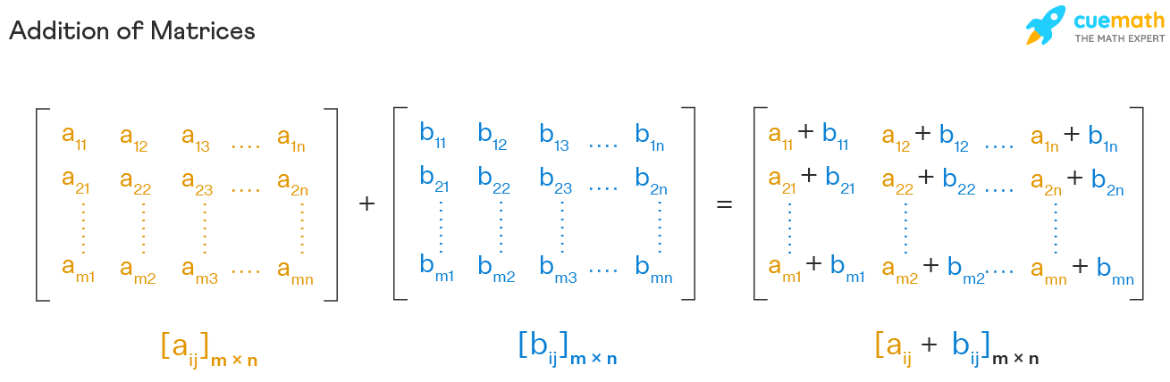
Matrix Operations:
Matrix Addition:
If A=[a_{ij}]_{mxn} and B=[b_{ij}]_{mxn} are two matrices of the same order, then their sum A + B is a matrix, and each element of that matrix is the sum of the corresponding elements, i.e. A + B = [a_{ij} + b_{ij}]_{mxn}
Consider the two matrices, A and B, of order 2 x 2. Then, the sum is given by:

Slide 14
The addition of matrices follows similar properties of the addition of numbers: commutative law, associative law, additive inverse, additive identity, etc. The following properties help in the addition matrix operations.
Commutative Property of matrix addition for the matrices A = [aij] and B = [bij] of same order m × n, is A + B = B + A.
Associative Property of matrix addition for the matrices A = [aij], B = [bij] and C = [cij] of same order m × n, is (A+B)+C = A+(B+C).
Additive Identity of matrix addition for a matrix A = [aij] of order m × n, is the zero matrix O of order m × n such that A + O = O + A = A.
Additive Inverse of matrix addition for the matrix A = [aij] of the order m × n, is -A = [−aij] of the same order m × n such that A + (-A) = O = A + (-A)..
Transpose Property of matrix addition for two matrixes A = [aij] and B = [bij] of same order is, (A + B)^{T} = A^{T} + B^{T}
Determinant Property of matrix addition for two matrixes A = [aij] and B = [bij] of same order is, |A + B| = |A| + |B|

Slide 15
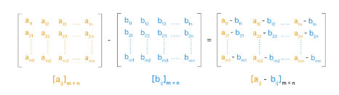
Matrix Subtraction:
If A=[a_{ij}]_{mxn} and B=[b_{ij}]_{mxn} are two matrices of the same order, then their sum A - B is a matrix, and each element of that matrix is the difference of the corresponding elements, i.e. A - B = [a_{ij} - b_{ij}]_{mxn}
Consider the two matrices, A and B, of order 2 x 2. Then, the Difference is given by:

Slide 16
The most important necessity for the subtraction of matrices to hold all these properties is that the subtraction of matrices is defined only if the order of the matrices is the same.
The number of rows and columns in the respective matrices should be the same for the subtraction of matrices.
The subtraction of matrices is not commutative, that is, A - B ≠ B - A
The subtraction of matrices is not associative, that is, (A - B) - C ≠ A - (B - C)
The matrix subtraction from itself results in a null matrix, that is, A - A = O.
Subtraction of matrices is the addition of the negative of a matrix to another matrix, that is, A - B = A + (-B).

Slide 17
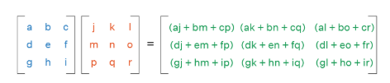
Multiplication - Matrix Operations
Two matrices A and B are said to be compatible if the number of columns in A is equal to the number of rows in B. The resultant matrix for the multiplication of a matrix A of order m × n with a matrix B of order n × p, is a matrix C of the order m × p. The multiplication of matrices does not follow commutative law, AB ≠ BA,.
There following properties of matrix multiplication are helpful for performing multiplication matrix operation.
Non-Commutative for matrix multiplication: Matrix multiplication is non-commutative, and the product AB is not equal to the product BA, AB ≠ BA.
Distributive proper over the addition of matrices for Matrix multiplication of matrix A and matrix B with another matrix C is A(B + C) = AB + BC.

Slide 18
Matrix multiplication with a Scalar k for matrices A and B, is defined as k(AB) = (kA)B = A(Bk).
Transpose property of matrix multiplication for two matrices A and B can be given as, (AB)^{T} = B^{T}A^{T}
Complex Conjugate property of matrix multiplication for two matrices A and B is (AB)* = B*A*
Associativity for matrix multiplication for three matrices A, B, and C, such that the products (AB)C and A(BC) are defined, as (AB)C = A(BC).
The scalar multiplication of matrix is the product of the scalar constant value with each of the elements of the matrix. The following properties of scalar multiplication of matrices is helpful in easily performing scalar multiplication of matrices. Here we have two matrices A, B and k, l are the scalar constant values.
K(A + B) = KA + KB
(K + l)A = KA + lA
(Kl)A = K(lA) = l(KA)

Slide 19
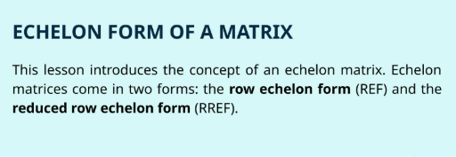
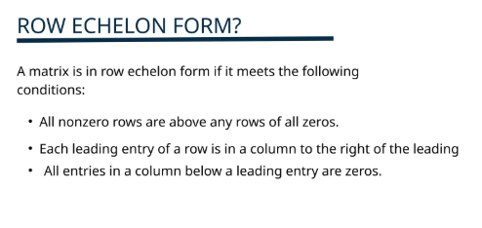

Slide 20
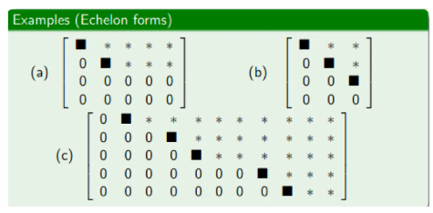
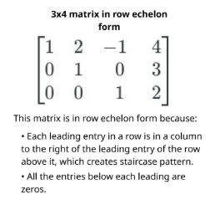
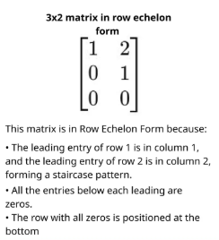

Slide 21
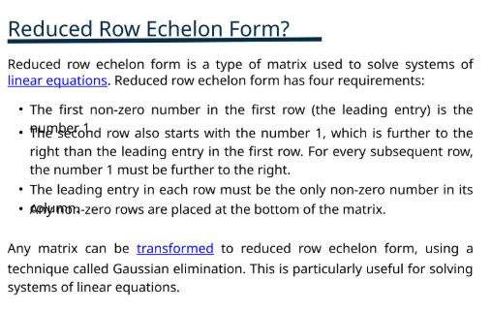
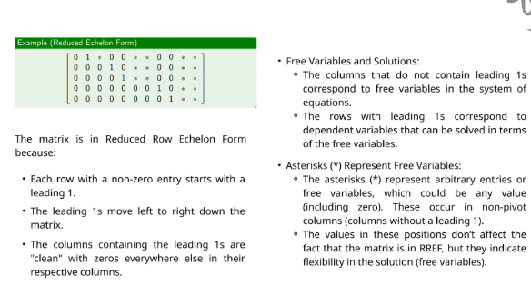

Slide 22
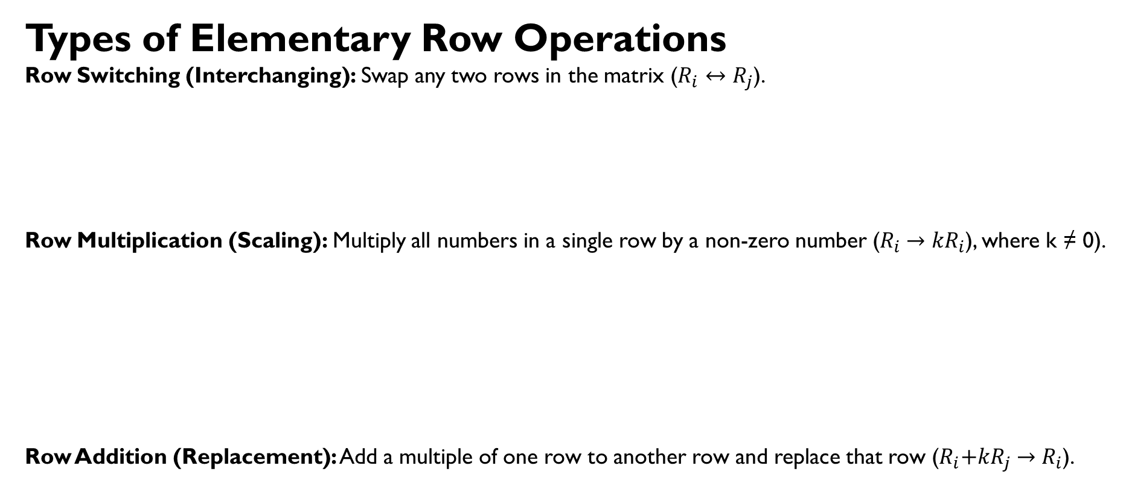
Types of Elementary Row Operations
Row Switching (Interchanging): Swap any two rows in the matrix ($R_{i}↔R_{j}$).
Row Multiplication (Scaling): Multiply all numbers in a single row by a non-zero number ($R_{i}{ →kR}_{i}$), where k ≠ 0).
Row Addition (Replacement): Add a multiple of one row to another row and replace that row ($R_{i}{+kR}_{j} →R_{i}$).

Slide 23
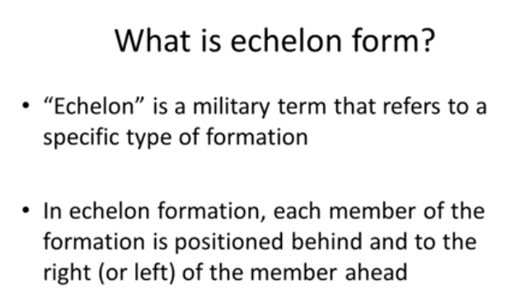

Slide 24


Slide 25
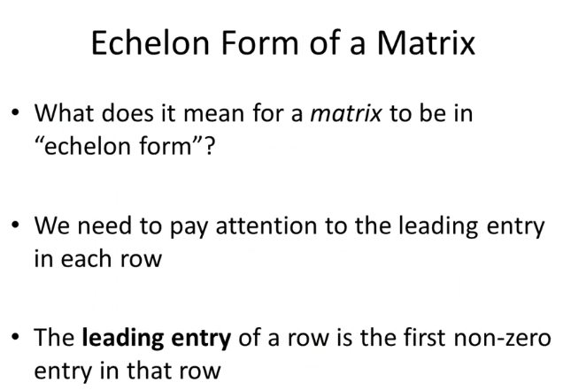
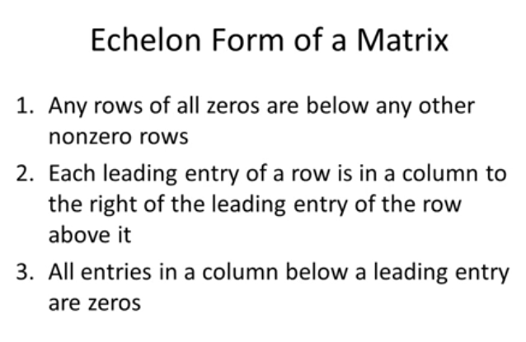

Slide 26
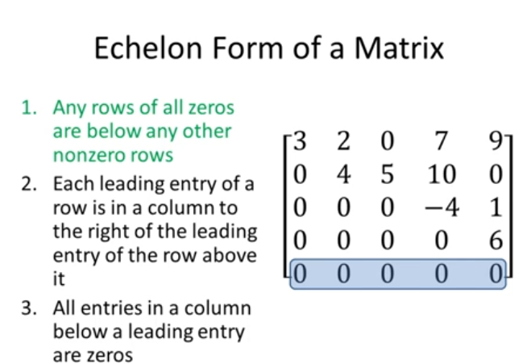

Slide 27
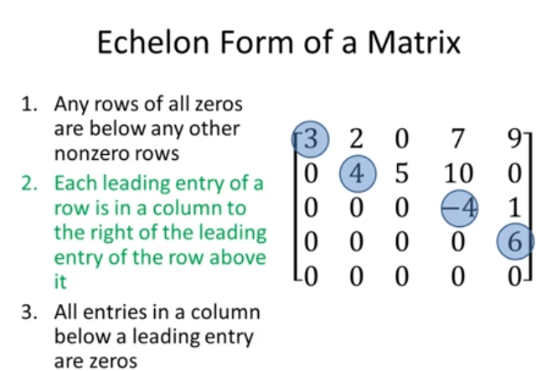

Slide 28
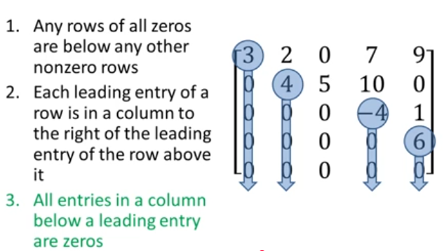

Slide 34
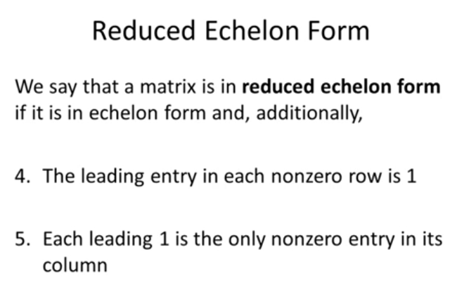

Slide 35
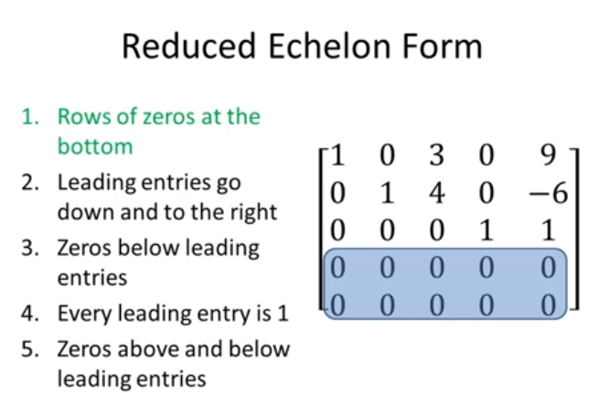

Slide 36
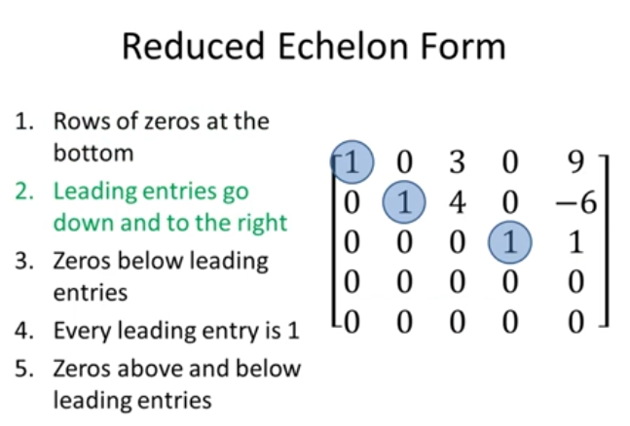

Slide 37
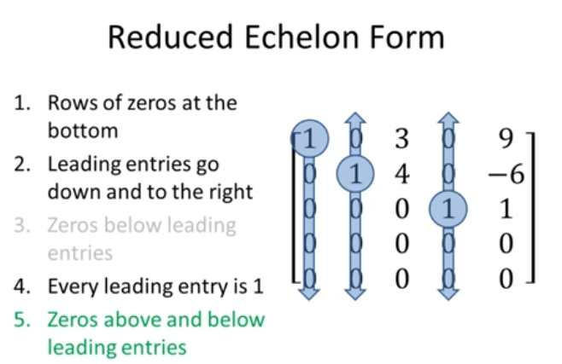

Slide 46
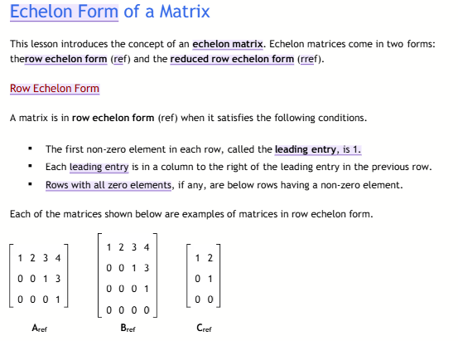

Slide 47
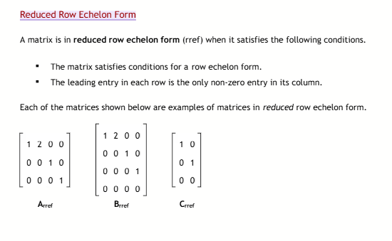

Slide 49
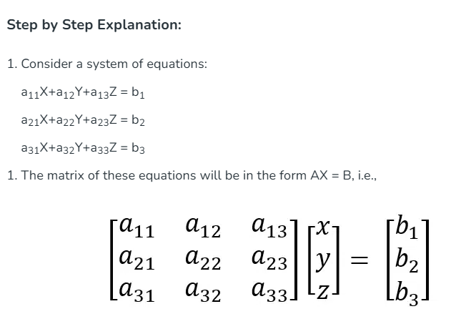
GAUSS JORDAN ELIMINATION

Slide 50
